Slide 1
Multi-Page Responsive Website
By k SHAHRUKH FAKRUDEEN

Slide 2
INTRODUCTION
Welcome to this presentation showcasing the development of a multi-page responsive website. The primary aim of this project is to deliver a dynamic and intuitive website that effortlessly adjusts to diverse devices and screen resolutions. By harnessing the power of cutting-edge web technologies such as HTML, CSS, and JavaScript, we have meticulously crafted an engaging and visually captivating online platform. Join us on this journey as we delve into the prominent features and functionalities of this website, while emphasizing its unwavering commitment to responsive design and user-centricity. Prepare to be inspired by the seamless integration of technology and aesthetics, resulting in an exceptional user experience.

Slide 3
Embark on an immersive journey as you step into our captivating landing page. Crafted meticulously using HTML, CSS, and JavaScript, the landing page welcomes visitors with an enticing visual design and an intuitive layout. Through a combination of stunning visuals, engaging content, and seamless navigation, users are drawn into the essence of our website. With responsive elements and carefully placed call-to-action buttons, the landing page ensures an optimized experience across various devices. Discover a world of possibilities as you explore the rich features and compelling offerings that await you.
Landing Page

Slide 4
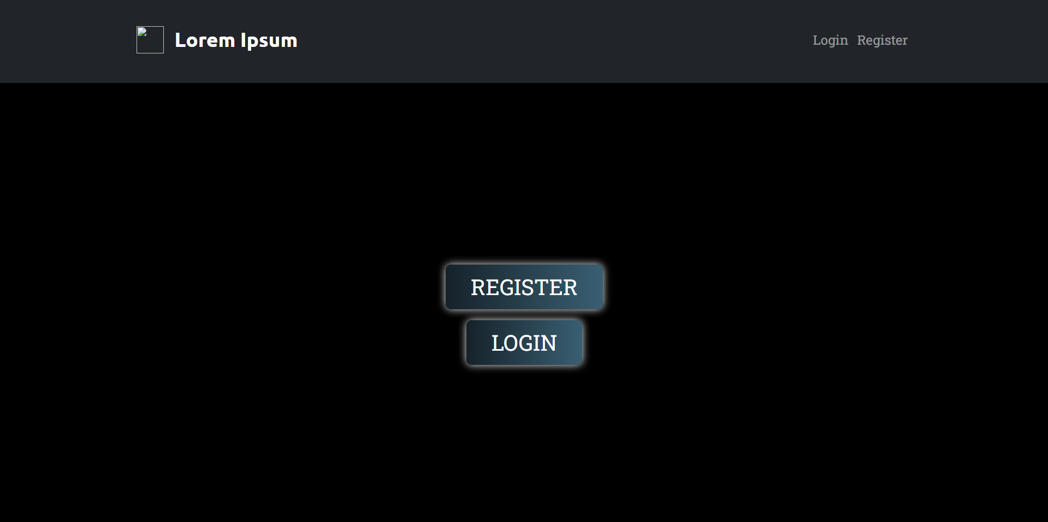

Slide 5
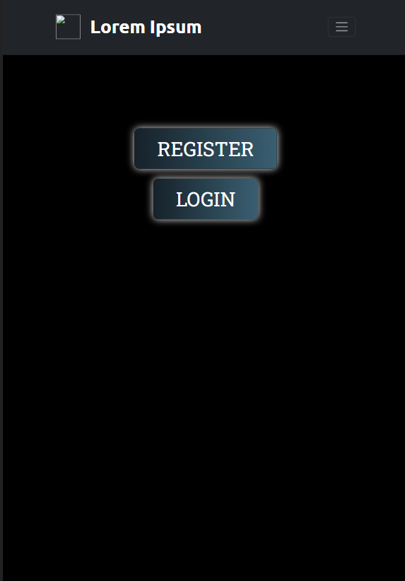
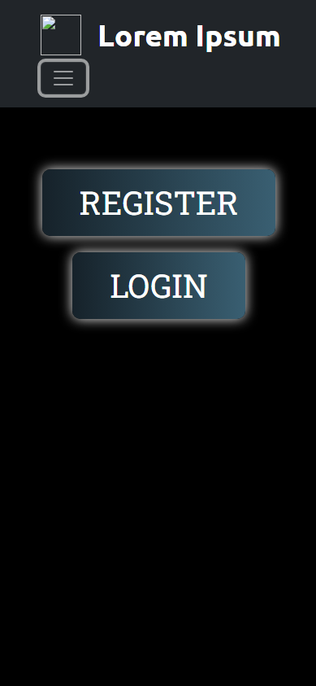
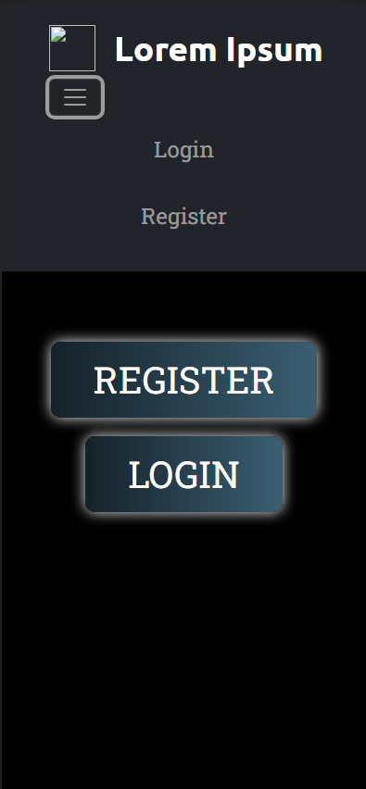

Slide 6
Experience a seamless and user-friendly registration process with our well-crafted register page. Powered by HTML, CSS, and JavaScript, this page allows new users to create their accounts effortlessly. The registration form, intelligently designed with validation checks, guides users through the process of entering their information securely. From input fields for personal details to password creation and validation, the register page ensures a smooth and error-free registration experience. With the implementation of JavaScript functionality, users can receive real-time feedback and validation as they complete the form, enhancing usability and minimizing errors.
Register Page

Slide 7
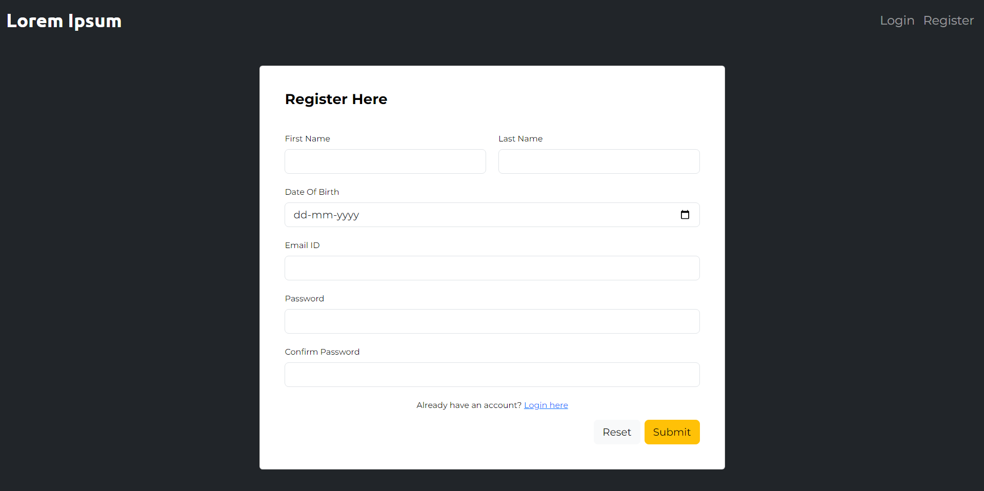

Slide 8
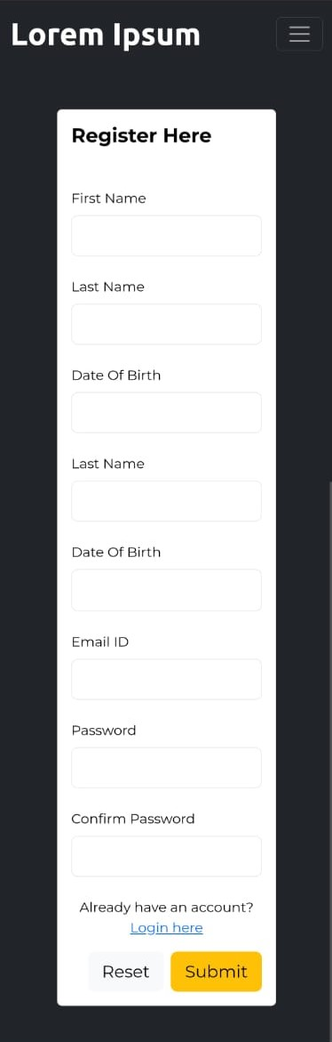
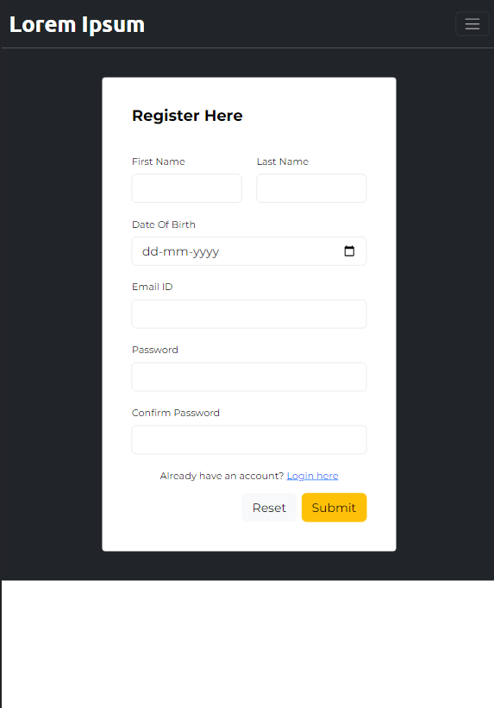

Slide 9
Welcome back to our secure and streamlined login page. Utilizing HTML, CSS, and JavaScript, the login page provides registered users with a convenient and secure gateway to their personalized accounts. The login form is carefully designed, with input fields for username and password, accompanied by user-friendly labels and clear instructions. JavaScript functionalities such as form validation and password encryption enhance security and improve the overall user experience. Users can confidently log in, knowing that their credentials are protected, and effortlessly access their personalized profiles and account settings.
Login Page

Slide 10
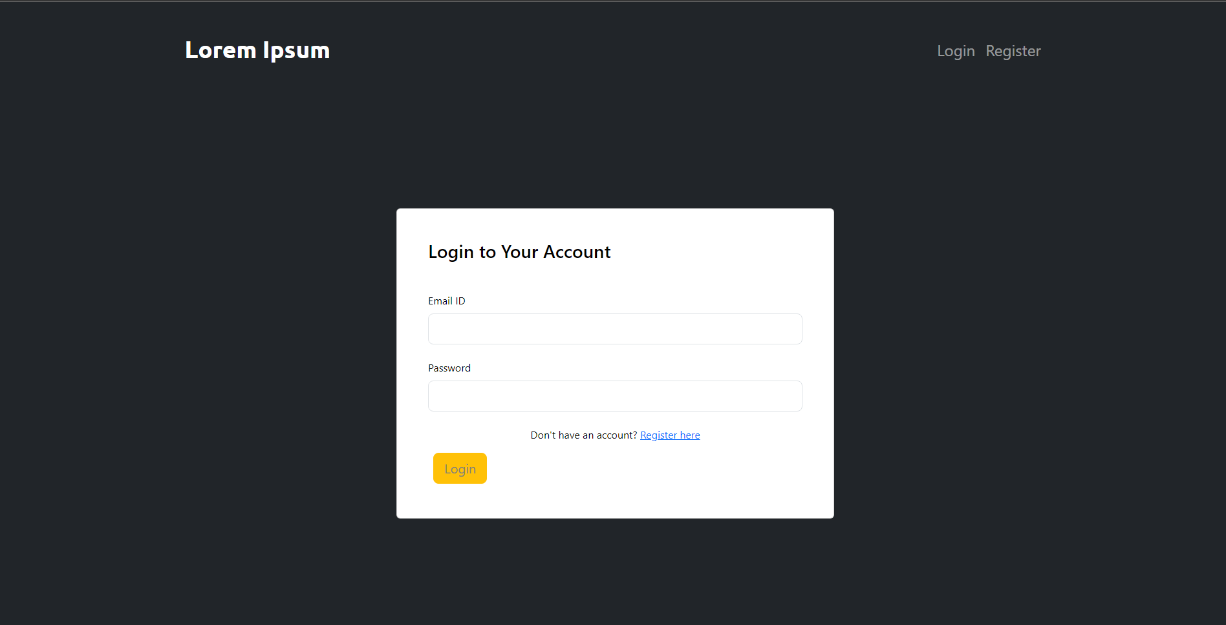

Slide 11
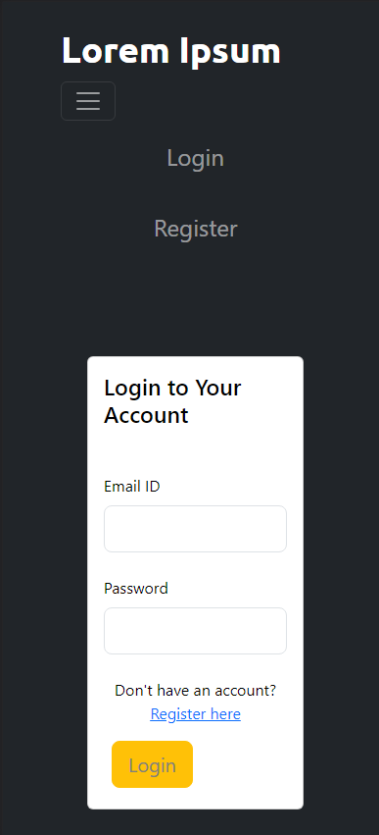
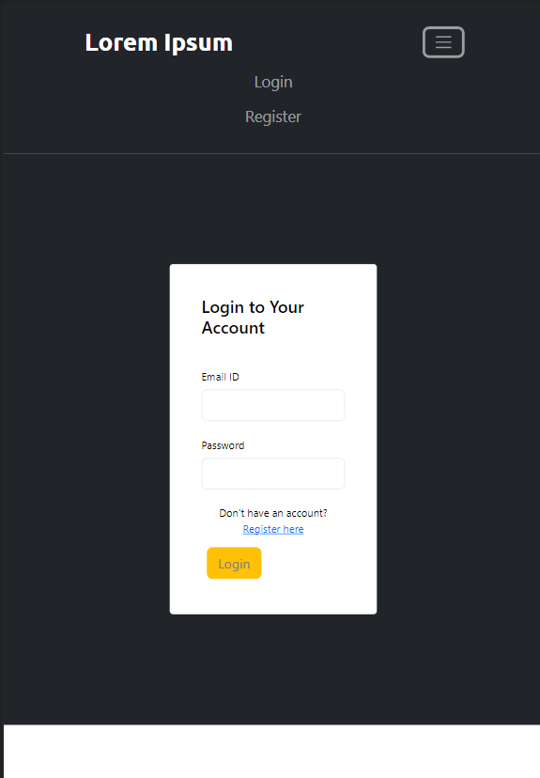
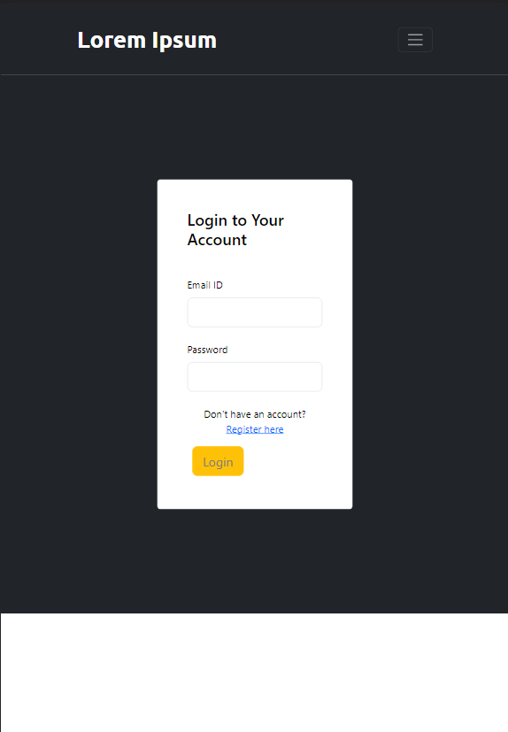

Slide 12
Unleash the power of personalization on our user-centric profile page. Developed using HTML, CSS, and JavaScript, this page allows users to showcase their individuality and interact within our online community. The profile page presents users with a visually appealing layout, displaying their profile picture, personal details, and other customizable features. JavaScript functionalities enable dynamic updates, such as image uploads and real-time data syncing. Users can effortlessly navigate their profiles, update information, and engage with other community members, fostering a sense of belonging and personal connection.
Profile Page

Slide 13
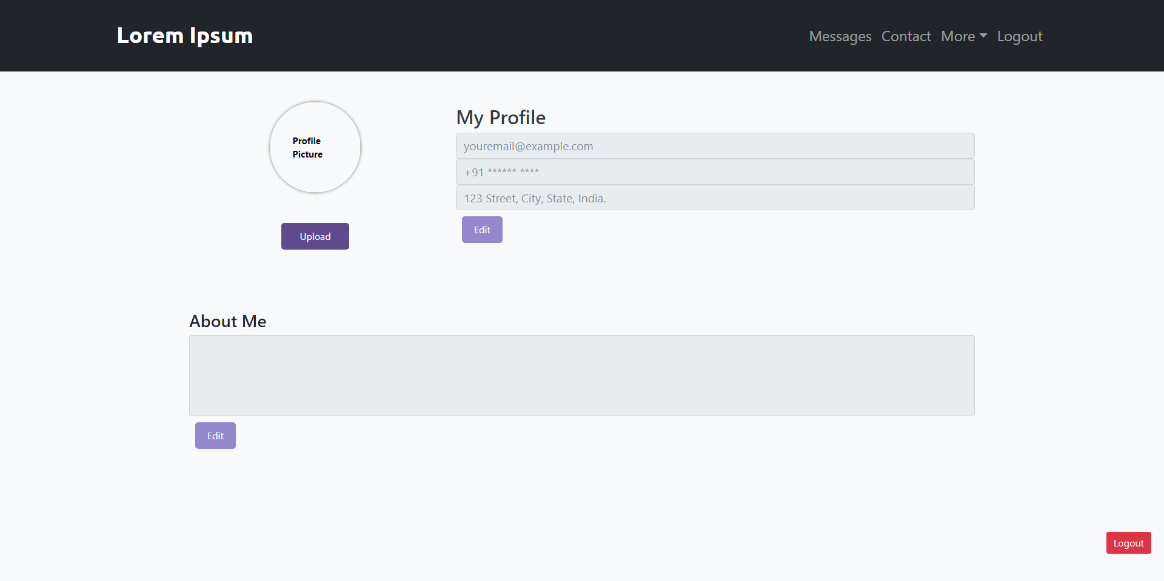

Slide 14
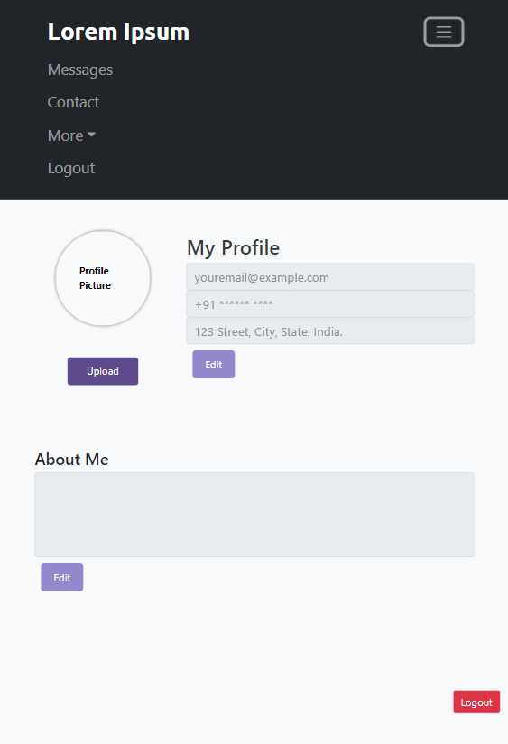
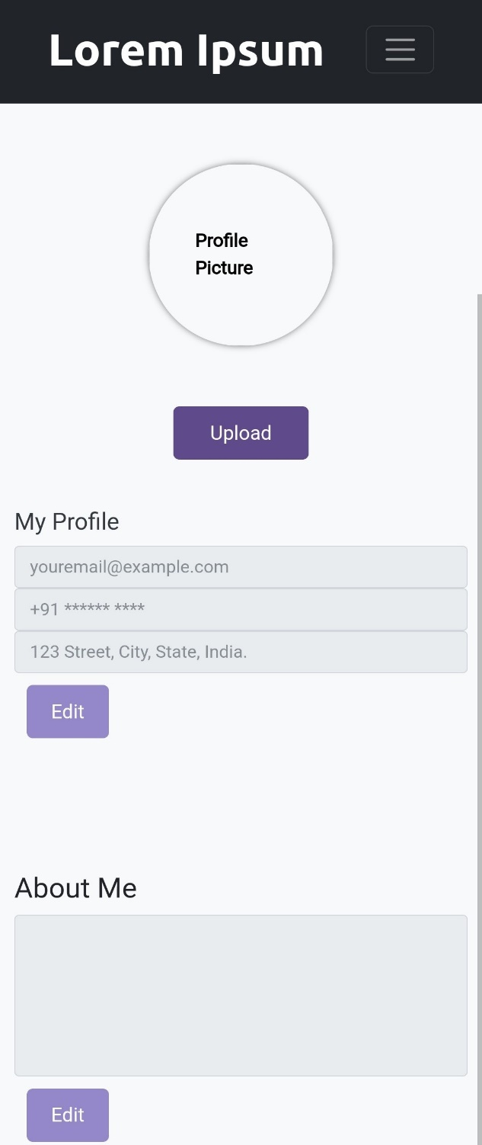

Slide 15
In conclusion, our multi-page responsive website project has successfully achieved its objectives of providing an engaging and user-friendly online experience. Through the utilization of HTML, CSS, and JavaScript, we have created a seamless journey for users, from the captivating landing page to the streamlined registration and login processes, all the way to the personalized profile page. Responsive design ensures accessibility across devices, allowing users to enjoy a consistent and optimized experience.
Future enhancements may involve expanding functionality and refining design elements to continuously cater to the evolving needs of our users. We are proud of the accomplishments we have made in creating a visually appealing, intuitive, and feature-rich website. The organization and utilization of code have allowed us to create a robust foundation for future growth and development.
Conclusion

